Slide 1
Introduction to MIKE Zero
A Project Oriented Working Environment

Slide 2
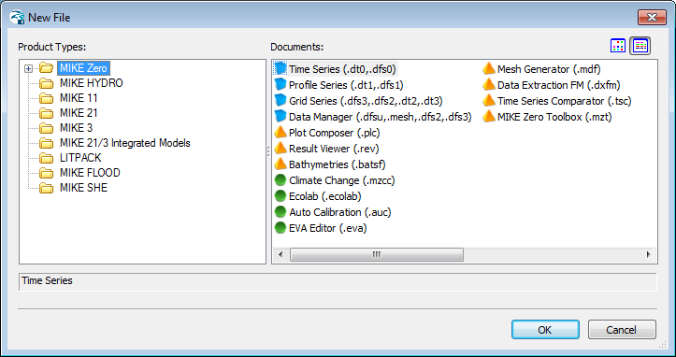
Introduction to MIKE Zero
A Common Interface to most MIKE Software Products,
including e.g. MIKE HYDRO, MIKE 21 and MIKE FLOOD

Slide 3
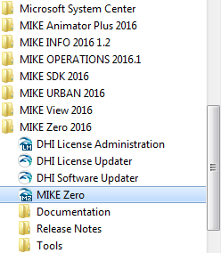
Introduction to MIKE Zero
Starting MIKE Zero
From Start > Programs > MIKE 20xx > MIKE Zero

Slide 4
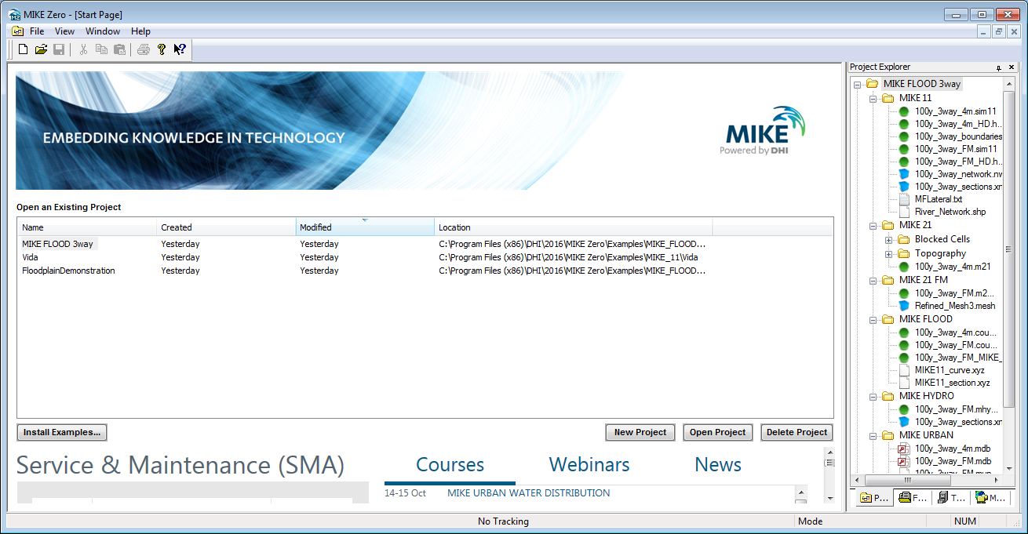
Introduction to MIKE Zero
START PAGE Creating, Deleting and Managing Projects

Slide 5
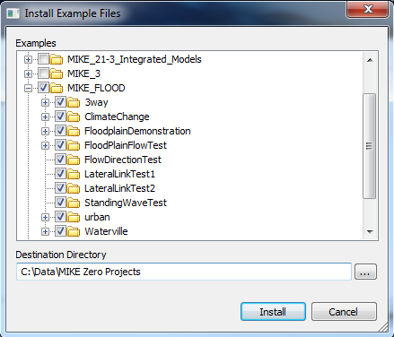
Introduction to MIKE Zero
START PAGE Installing Examples

Slide 6
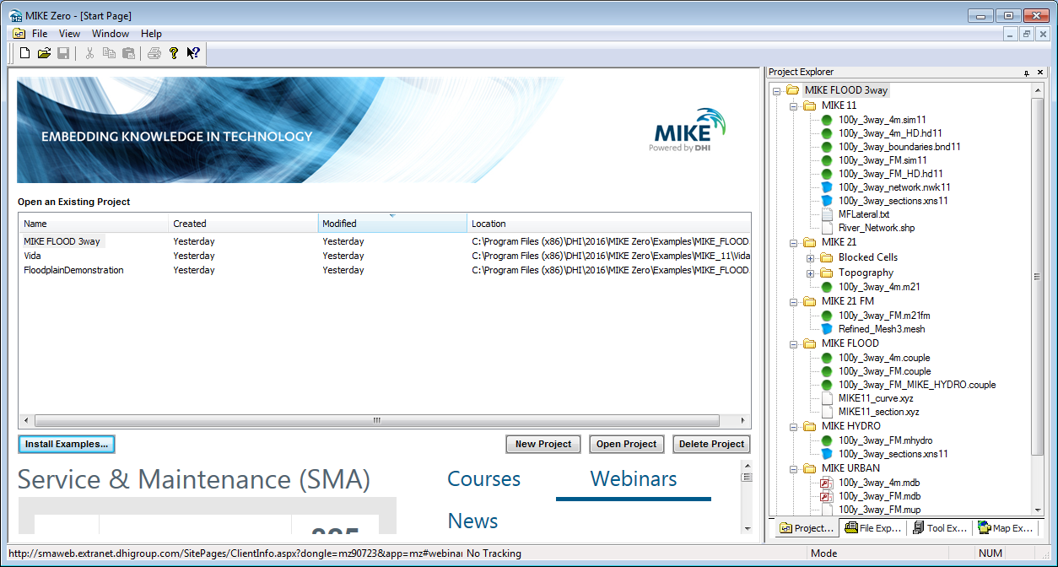
Introduction to MIKE Zero
PROJECT EXPLORER Easy Access to All Project Data
Project Explorer lists all files included in a project according to their placement in folders

Slide 7
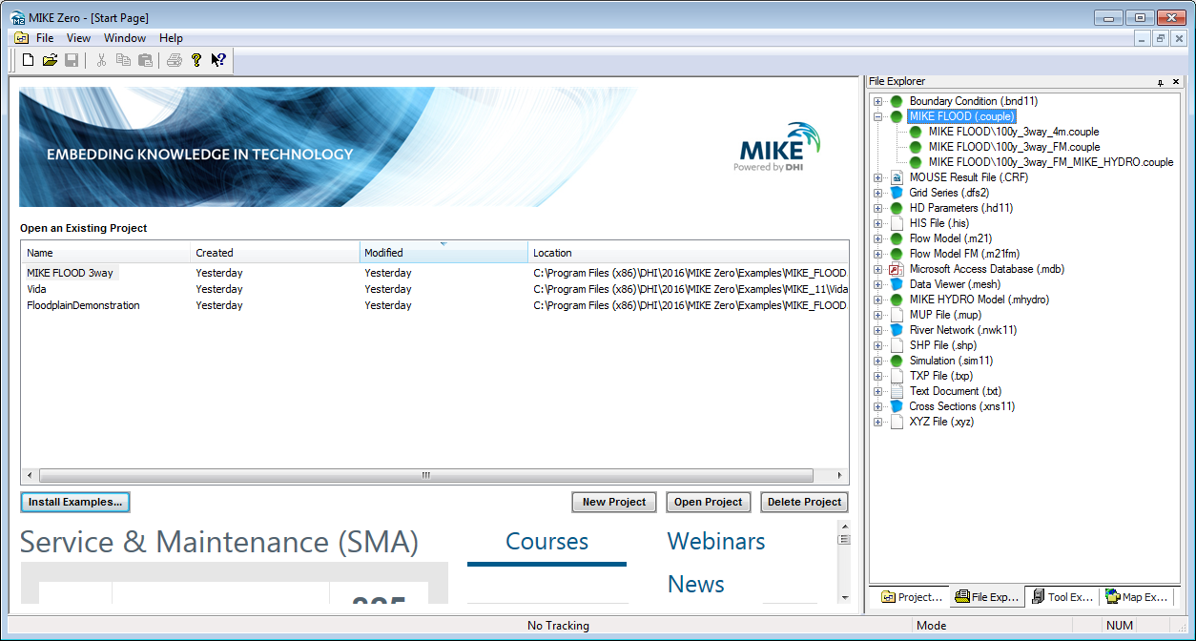
Introduction to MIKE Zero
FILE EXPLORER Quick Overview/Grouping of Files by Type
File Explorer lists
all files included in a project according to the
file type

Slide 8
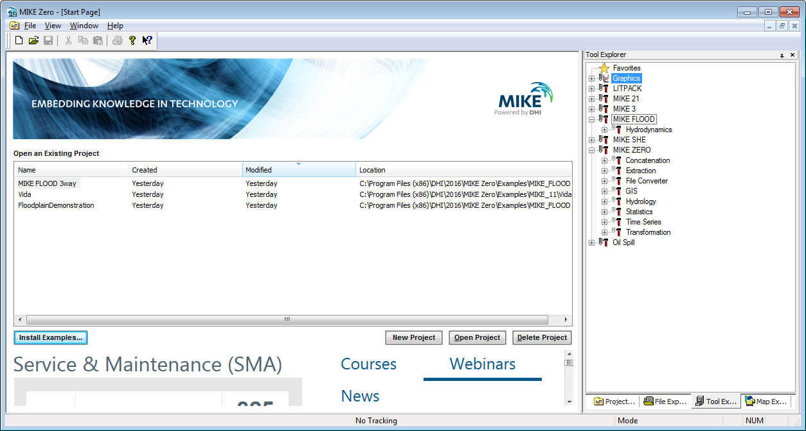
Introduction to MIKE Zero
TOOL EXPLORER Convenient Collection of All Toolboxes
Tool Explorer allows you to access all toolboxes, with a user controlled favorite folder contains links to frequently used tools and settings

Slide 9
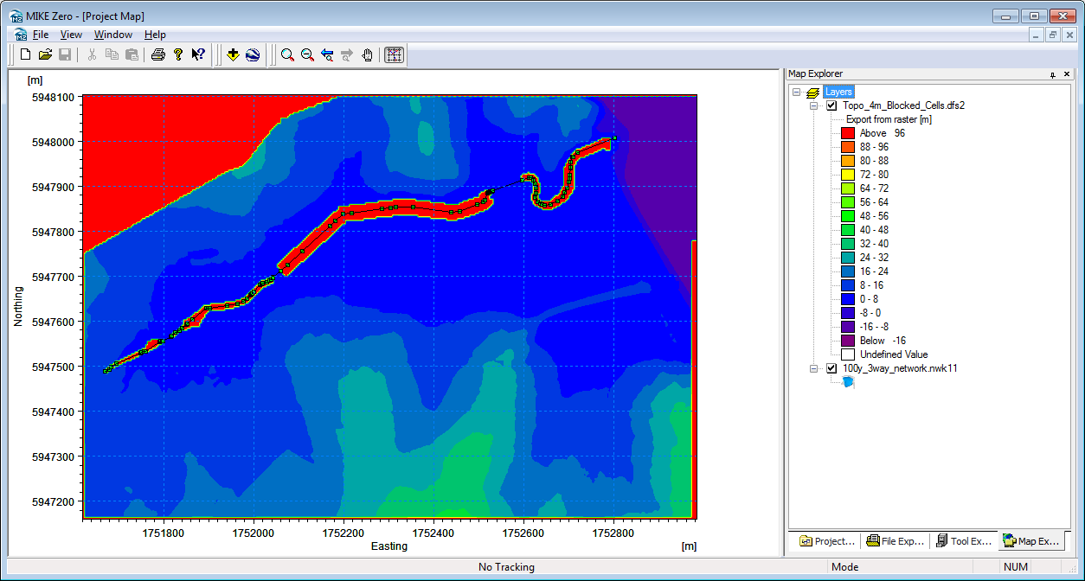
Introduction to MIKE Zero
MAP EXPLORER List of layers in Project Map
Map Explorer allows you to list the files displayed in the Project Map. The files can also be displayed in Google Earth (right-click option)

Slide 10
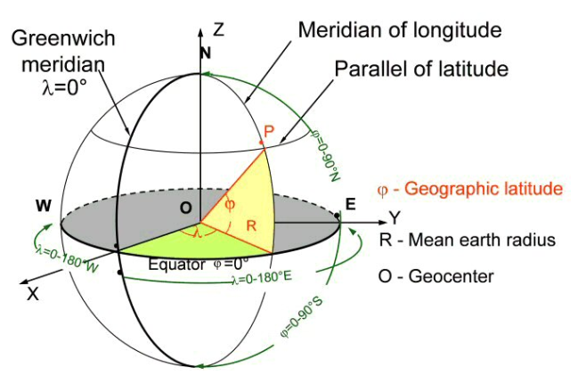
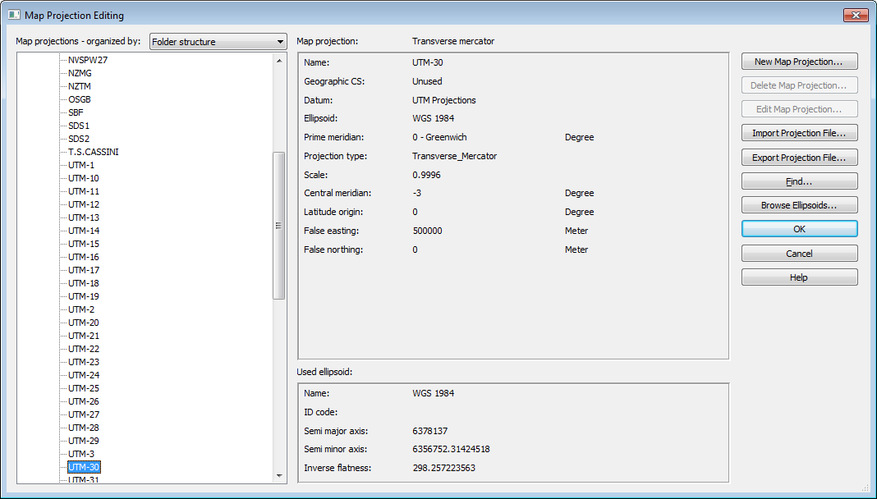
Introduction to MIKE Zero
OPTIONS IN MIKE Zero Map Projection Standard
How? MIKE Zero -> File -> Options -> Edit Map Projections
Adoption of the OpenGIS consortium (used by ESRI and others) convention and file format (PRJ) for describing map projections

Slide 11
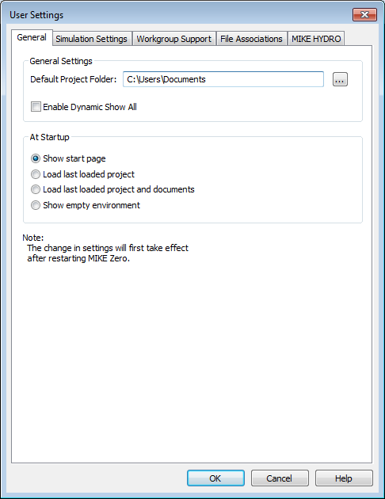
Introduction to MIKE Zero
OPTIONS IN MIKE Zero
User Settings
How? MIKE Zero -> File -> Options -> User Settings
General
Simulation Settings:
Support for workgroups
File Associations
MIKE HYDRO

Slide 12
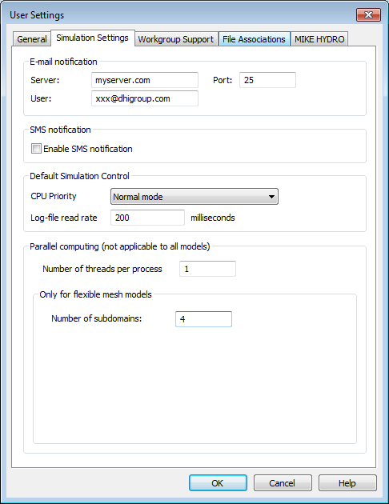
Introduction to MIKE Zero
OPTIONS IN MIKE Zero
User Settings
How? MIKE Zero -> File -> Options -> User Settings
General
Simulation Settings
Support for workgroups
File Associations
MIKE HYDRO

Slide 13
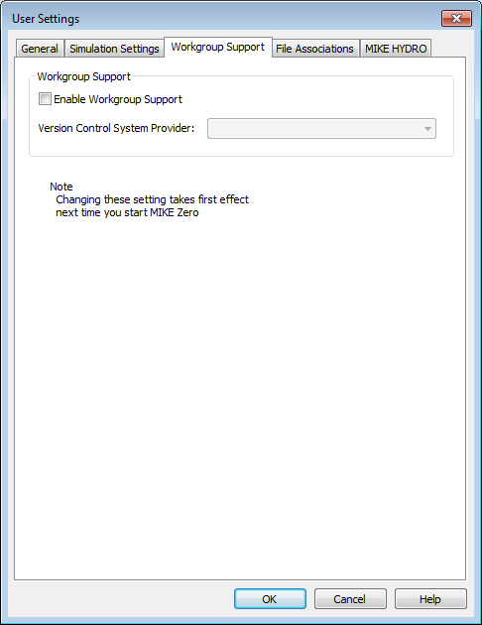
Introduction to MIKE Zero
OPTIONS IN MIKE Zero
User Settings
How? MIKE Zero -> File -> Options -> User Settings
General
Simulation Settings
Support for workgroups (version control system - VCS)
File Associations
MIKE HYDRO

Slide 14
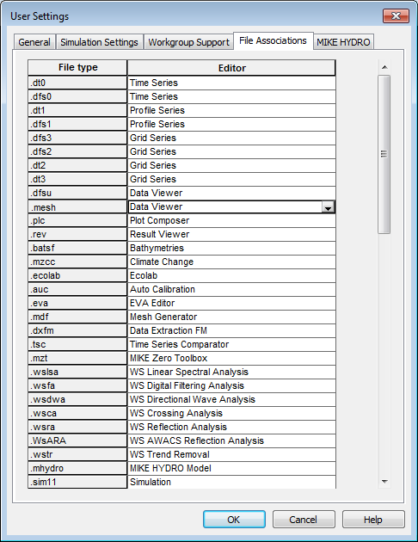
Introduction to MIKE Zero
OPTIONS IN MIKE Zero
User Settings
How? MIKE Zero -> File -> Options -> User Settings
General
Simulation Settings
Support for workgroups
File Associations
MIKE HYDRO

Slide 15
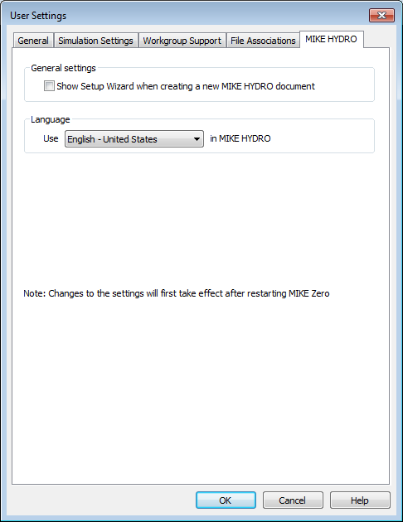
Introduction to MIKE Zero
OPTIONS IN MIKE Zero
User Settings
How? MIKE Zero -> File -> Options -> User Settings
General
Simulation Settings: Notifications (SMS & Email)
Support for workgroups (version control system - VCS)
File Associations
MIKE HYDRO

Slide 16
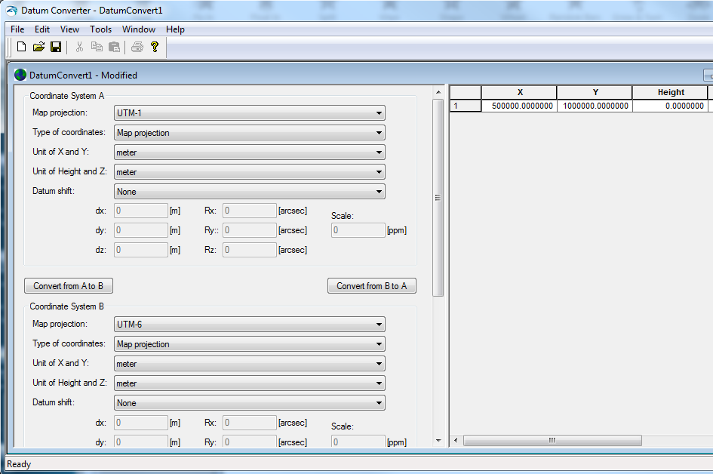
Introduction to MIKE Zero
OPTIONS IN MIKE Zero
New Datum Conversion Tool
How? MIKE Zero -> File -> Options -> Datum Convert
Convert spatial (XYZ) data coordinates from one coordinate system to another
Supports batch execution!

Slide 17
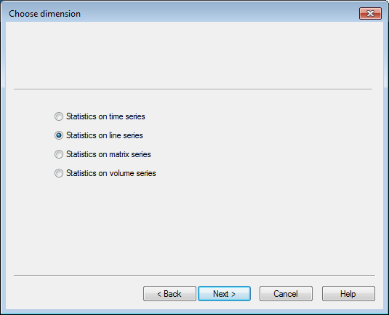
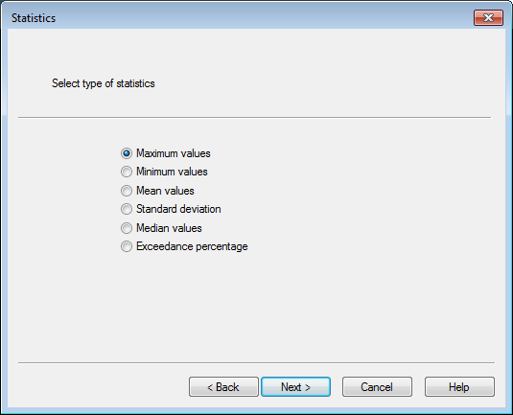
Introduction to MIKE Zero
TOOLBOXES in MIKE Zero
MIKE Zero Toolbox
How? MIKE Zero -> Tool Explorer -> MIKE Zero -> Statistics
Line series (.dfs1 data) statistics now included
Exceedance statistics of .dfs1/2/3 data files, ie. percentage of exceedance given a threshold value

Slide 18
Introduction to MIKE Zero
CREATING NEW FILES
DHI Software File Icon Structure
How? MIKE Zero -> File -> New -> File
Separate icons for:
Data
Models
Tools

